Slide 1

Hierarchical Attention Networks for Text & Document Classification
180030120
180030887
180030956
180031226

Slide 2
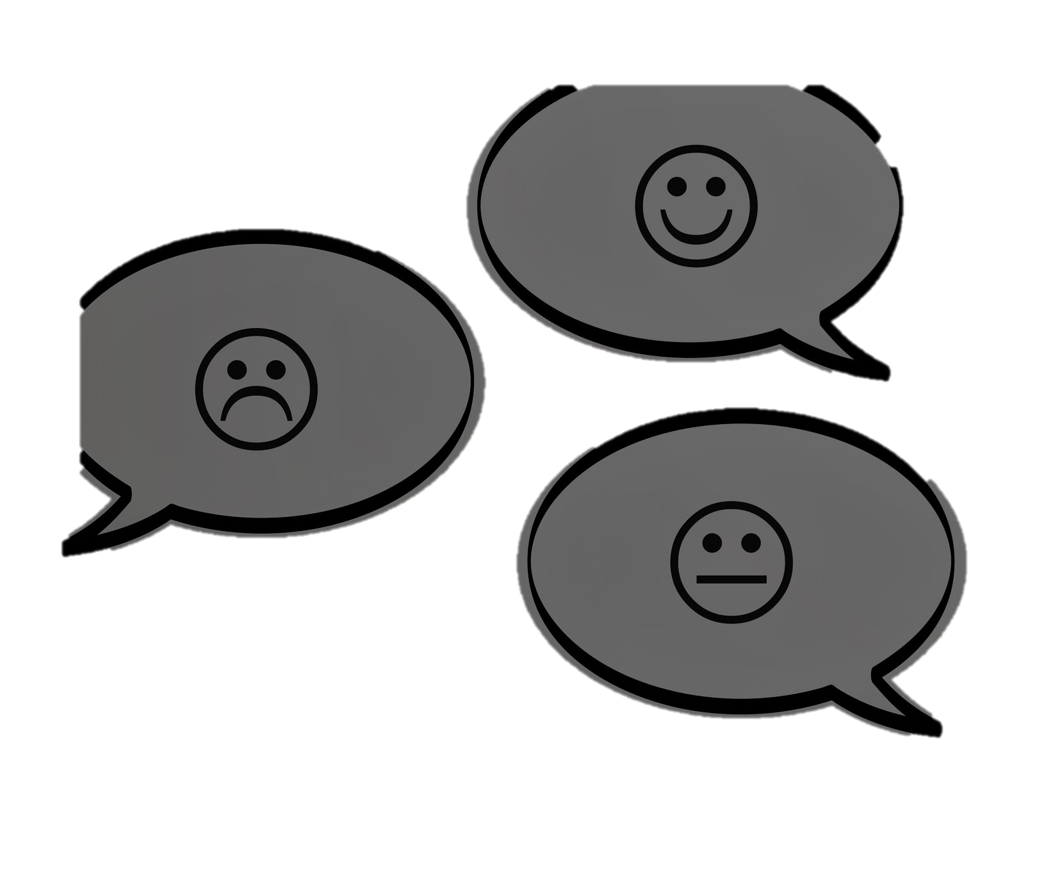
Problem Statement
To build a hierarchical attention networks model for the text and document classification.

Slide 3

Abstract
Text classification is a fundamental task in natural language processing.
The goal is to assign unstructured documents (e.g., reviews, emails, posts, website contents, etc.) to one or more categories.
These categories can be review ratings, such as star ratings, spam rating versus non-spam rating, or topic rating.
We use Hierarchical attention networks for text and document classification.

Slide 4

Hierarchical attention network uses word-level stacked recurrent neural networks followed by an attention model to extract such words important to the meaning of the sentence and assemble the representation of those useful words to form a sentence vector.
Then the same procedure is applied to the derived sentence vectors which then generates a vector that visualizes the meaning of the given document, and this vector can be bypassed to classify Text.

Slide 5
Bidirectional RNN and attention networks are the two parts that constitute the attention model.
The bidirectional RNN returns a vector for each word by learning the meaning behind this word sequence.
The attention network uses its shallow network to obtain corresponding weights for each word vector and calculate the weighted sum.
This weighted sum captures the entire sentence and the same procedure is applied to sentence vectors so that the final vector can capture the essence of the entire document.
Since it works in two levels as an attention model, it is called hierarchical attention networks.

Slide 6
So, our model has two unique characters
A hierarchical structure that mirrors the hierarchical structure of documents.
Two levels of attention mechanisms applied at the word as well as sentence level, enabling it to attend differentially to more and less important content when constructing the document and text representation.
The main contribution of this work is the use of convolution layers to extract more meaningful, generalizable and abstract features by the hierarchical representation.

Slide 7
List of Applications
Marketing
Reviews
Tagging content
Sentiment Analysis

Slide 8
Word Level Flowchart

Slide 9
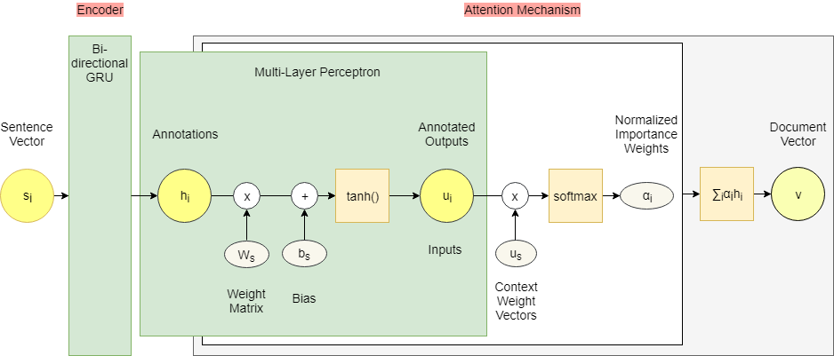
Sentence Level Flowchart

Slide 10
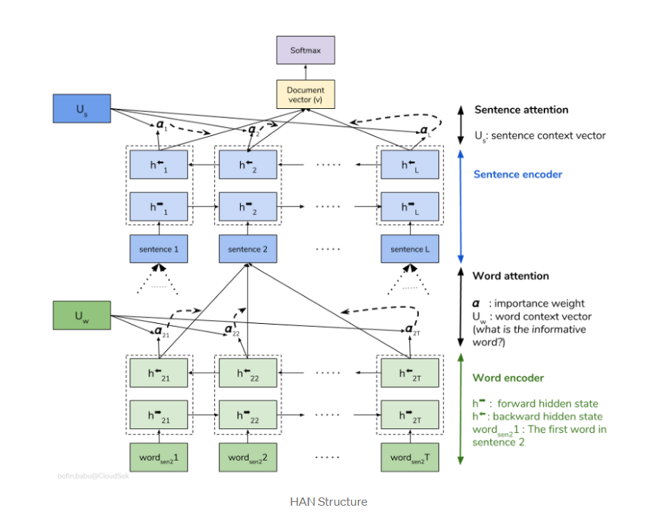

Slide 11

Project Workflow
Sentence Encoder
Embedding Layer
Sentence Attention
4
Word Encoder
Fully Connected Layer + Softmax
1
5
Word Attention
2
6
3

Slide 12
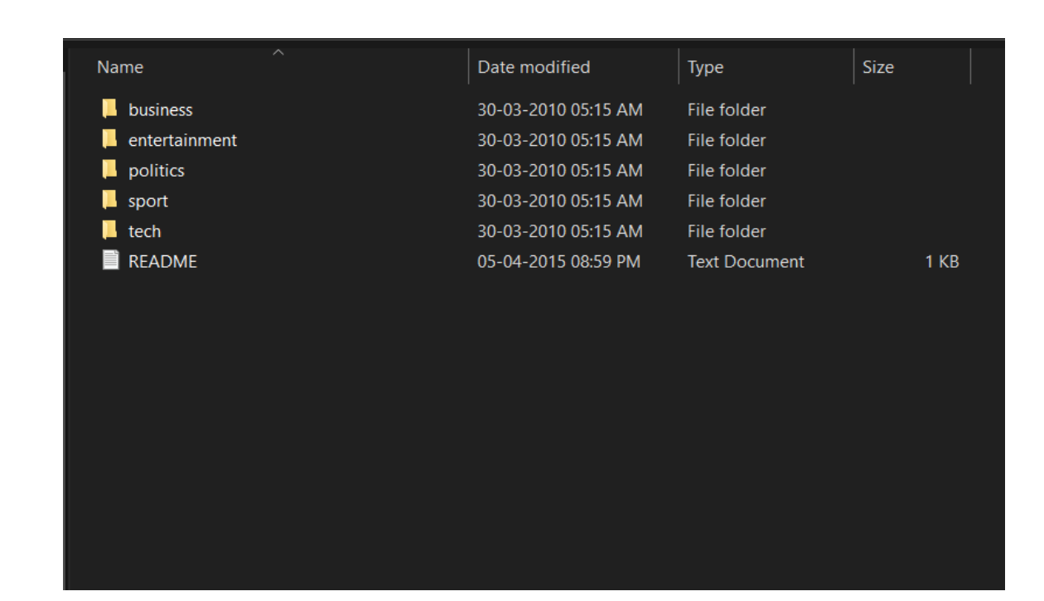

Slide 13
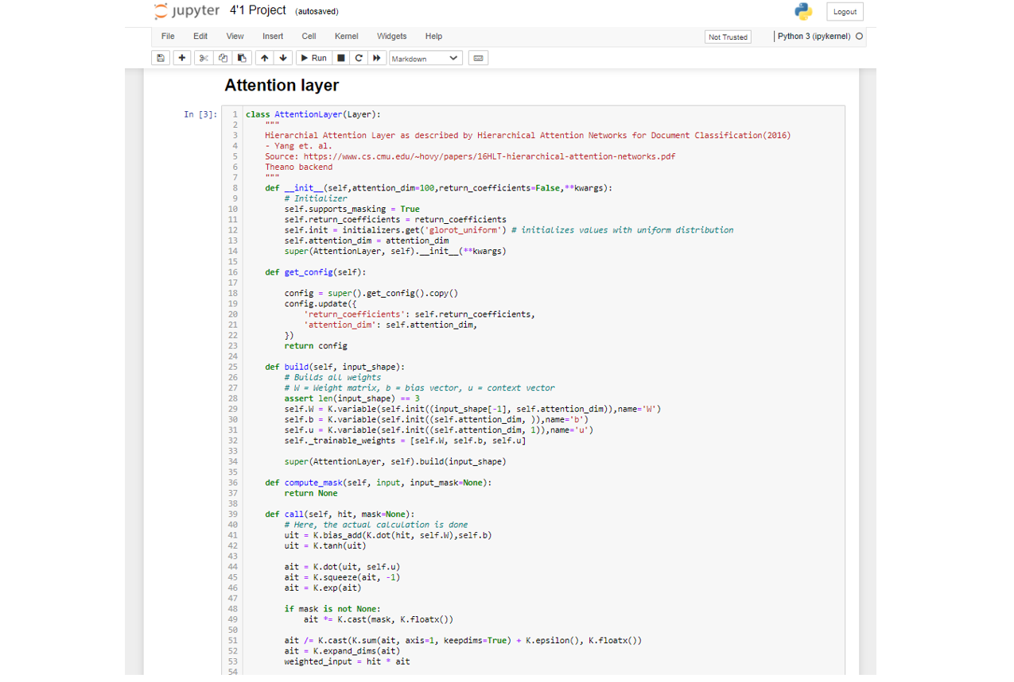

Slide 14
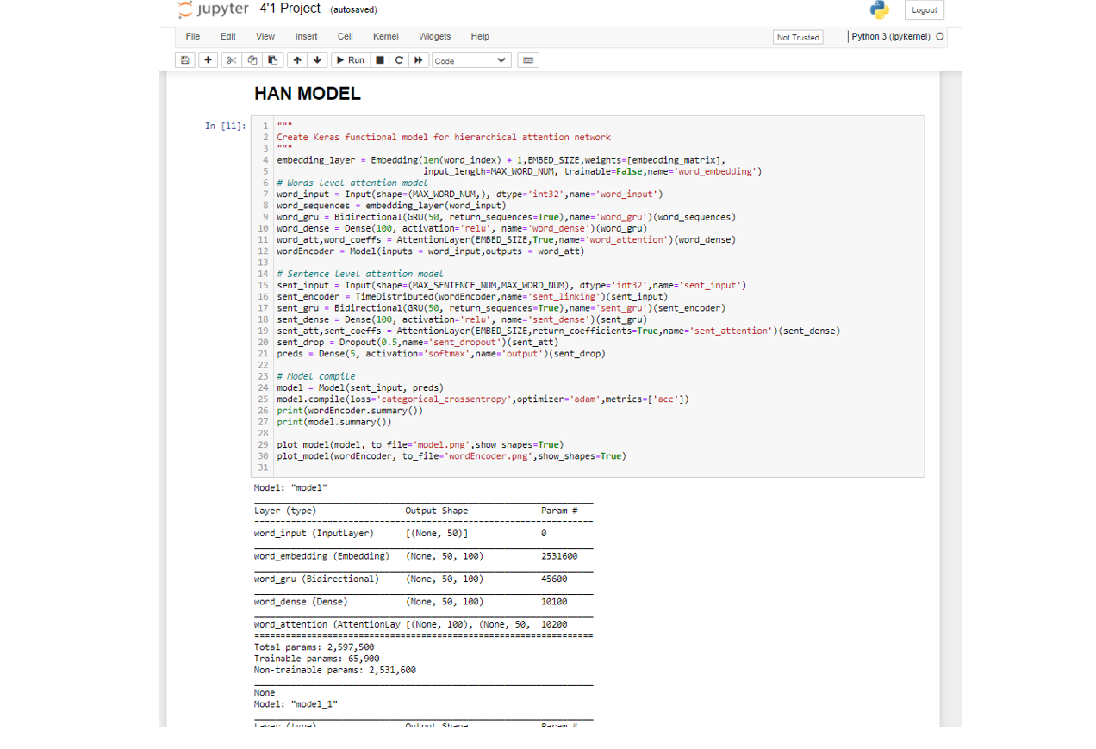

Slide 15
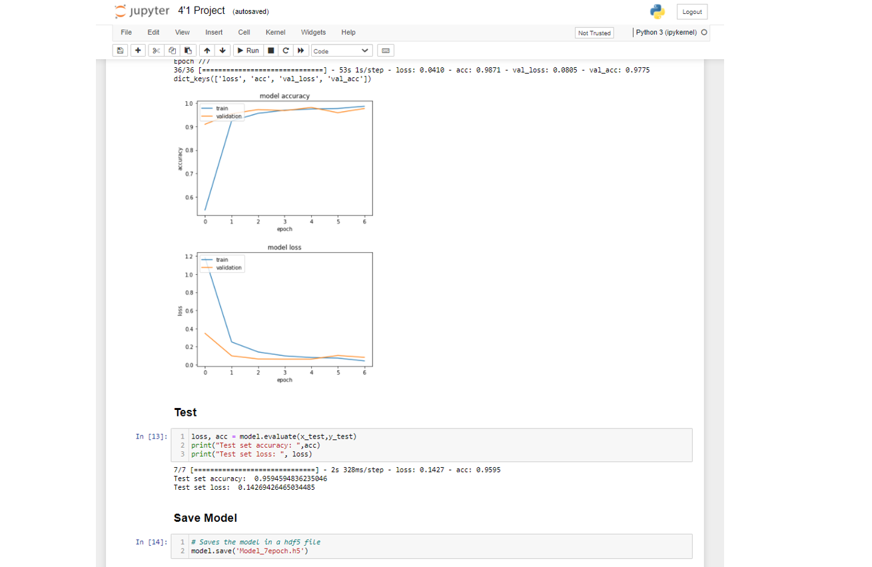

Slide 16
Conclusion and Future Scope
In this paper, we proposed hierarchical attention networks (HAN) for classifying documents.
As a convenient side-effect we obtained better visualization using the highly informative components of a document.
Experimental results demonstrate that our model performs significantly better than previous methods.
Visualization of these attention layers illustrates that our model is effective in picking out important words and sentences.

Slide 17
Thanks!

